Slide 1
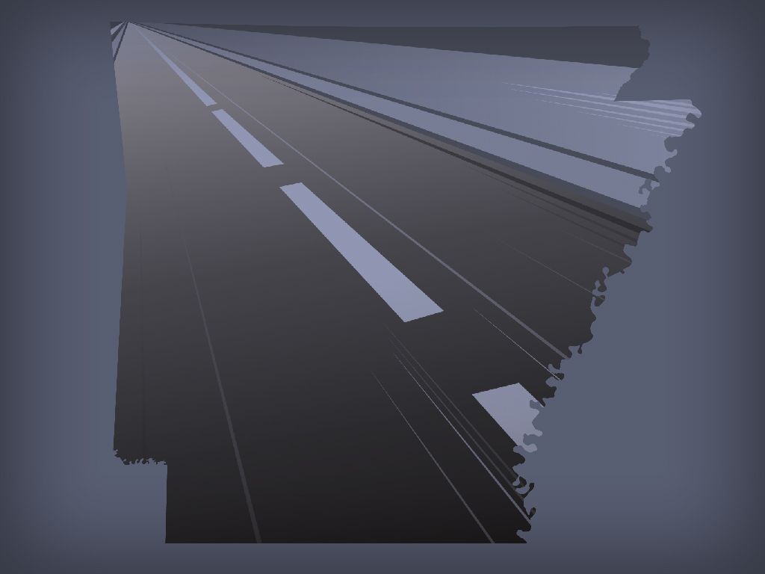

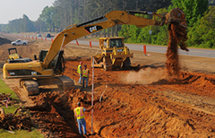
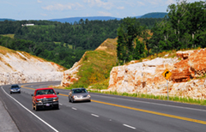
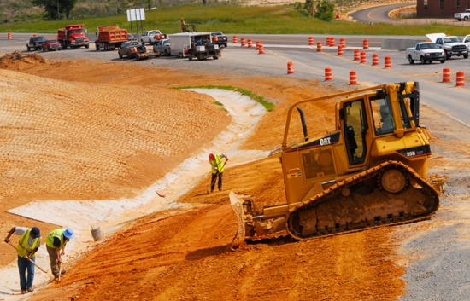
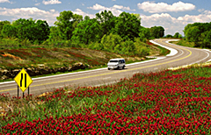

Slide 2

Expect the Unexpected!
Don’t Barrel through Work Zones!
ARKANSAS DEPARTMENT OF TRANSPORTATION

Slide 3

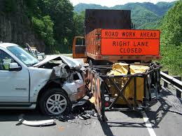
Arkansas Department of Transportation
Everyday Encounters in Maintenance
Objective: Identify day to day hazards field personnel face.
Notes:
We have so many different encounters as field personnel.

Slide 4
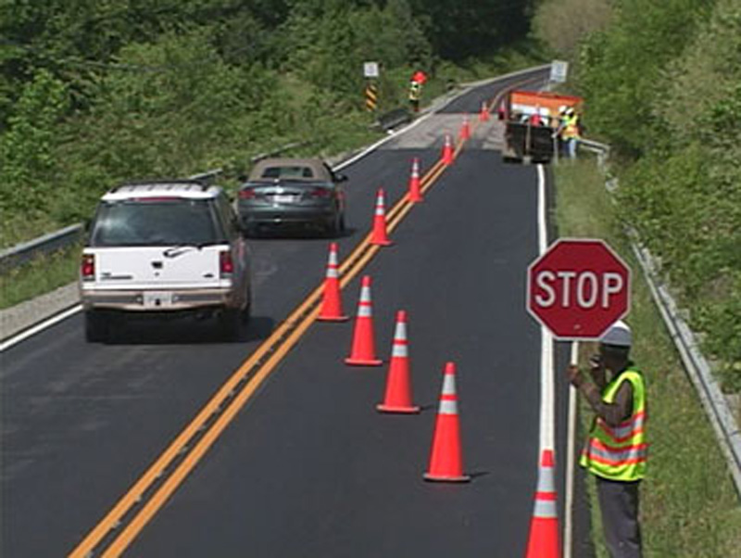
Arkansas Department of Transportation
Are we sitting ducks while performing our day to day task as field personnel?
Notes:
What does it mean when I say are we sitting duck? Unprotected, vulnerable, easy target

Slide 5
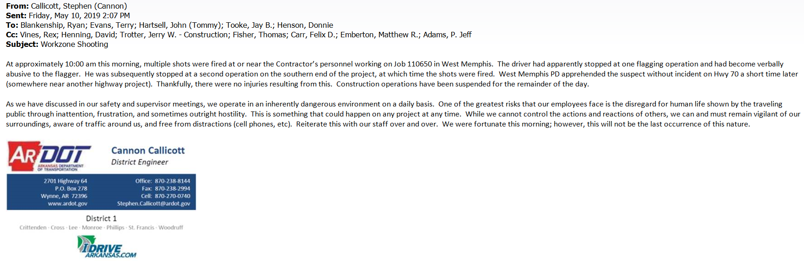
Arkansas Department of Transportation
Notes:
What does it mean when I say are we sitting duck? Unprotected, vulnerable, easy target

Slide 6
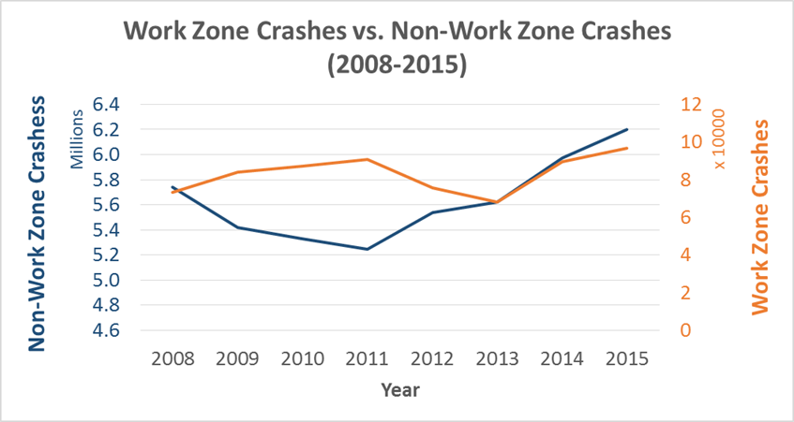
Work Zone Crashes
Arkansas Department of Transportation
Notes:
Work zones crashes rose 42% from 2013-2015

Slide 7
Statistics
Arkansas Department of Transportation
96,626
Work Zone crash occurs once every 5.4 minutes
Daily: 70 crashes occur that result in injury
Weekly: 12 crashes occur that result in fatality
Notes:
2015
11.1 crashes per hour

Slide 8
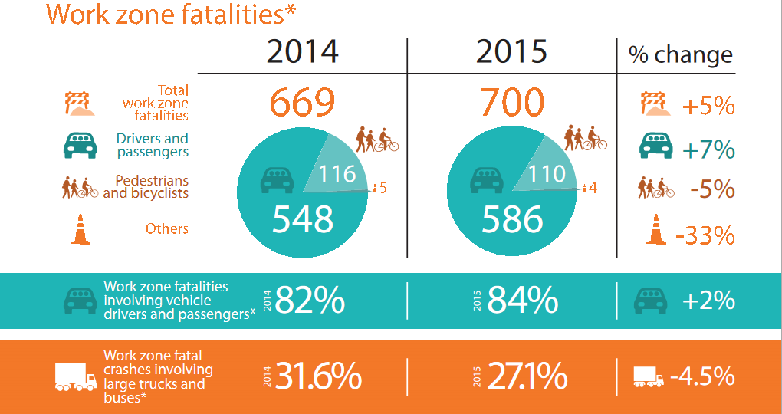
Work Zone Fatalities
Arkansas Department of Transportation

Slide 9
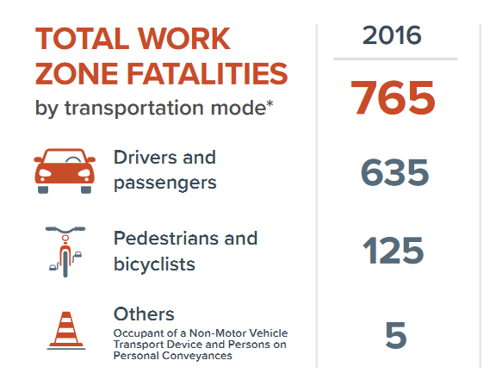
Work Zone Fatalities
Arkansas Department of Transportation

Slide 10
Arkansas Crashes/Fatalities
Arkansas Department of Transportation
Year | Number of Work Zone Related Crashes | Fatalities
2012 | 1864 | 10
2013 | 2463 | 13
2014 | 2790 | 10
2015 | 794 | 12
2016 | 1460 | 12
2017 | 2085 | 17
Total | 11456 | 74

Slide 11
Characteristics of Work Zone Fatal Crashes
Arkansas Department of Transportation
Crash Factors
Location of Crashes
Type of Crashes
Notes:
Just put crash factors, location of crashes and Type of crashes on this slide

Slide 12
Drowsy Driving
Arkansas Department of Transportation
Claimed 795 lives in 2017
Drowsy Driving Crashes
  12:00 a.m. - 6:00 a.m.
  Single Driver
  Highways/Rural Roads
Notes:
People experience a dip in circadian rhythm, the body’s internal clock that regulates sleep; evidence of no braking

Slide 13
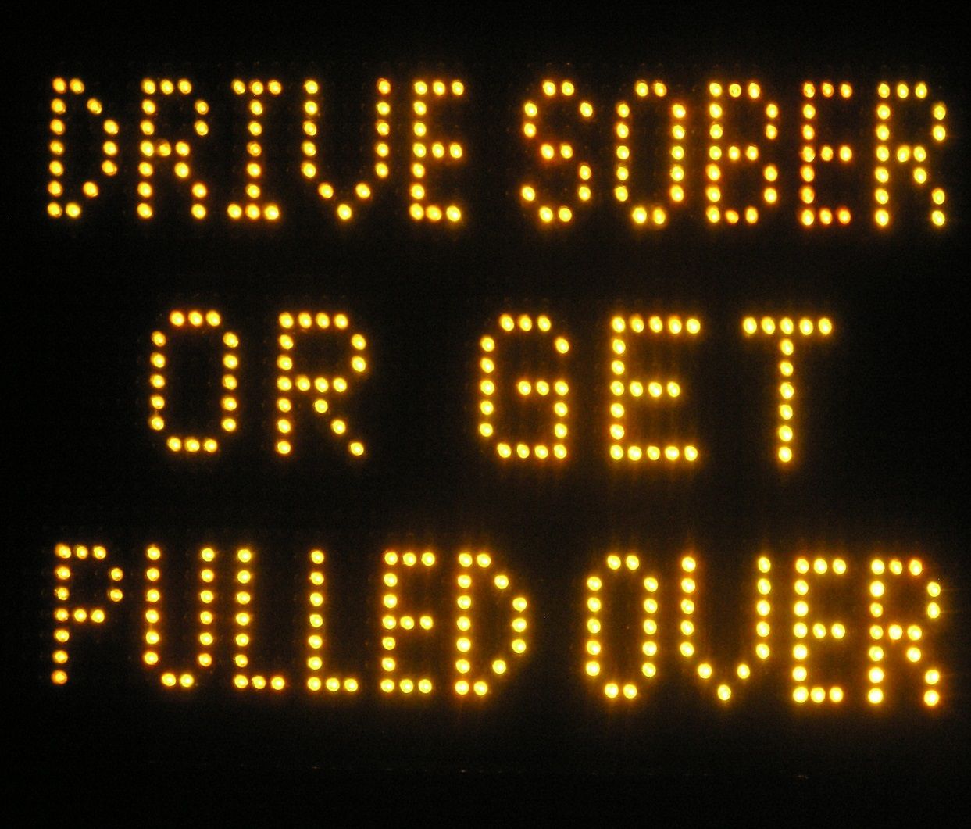
Drunk Driving
Arkansas Department of Transportation
30 people daily lose their life
  1 person every 48 minutes
Claimed 10,874 lives in 2017
Notes:
(After first point)These deaths have fallen by a third in the last three decades.

Slide 14
Drug-Impaired Driving
Arkansas Department of Transportation
Cocaine and methamphetamine can make drivers more aggressive and reckless
Marijuana and other drugs can slow coordination, judgement and reaction times
Prescriptions and OTC medicines can cause extreme drowsiness, dizziness or other side effects
Notes:
If you feel different, you drive different

Slide 15
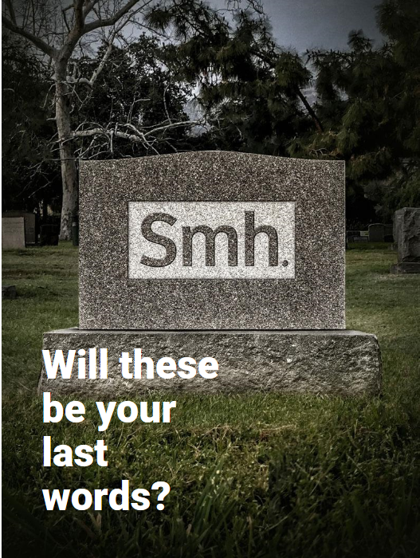
Distracted Driving
Arkansas Department of Transportation
Claimed 3,450 lives in 2016
  Eating
  Talking
  Stereo
Texting is the most alarming distraction
481,000 drivers use cell phones while driving
Notes:
Anything that takes your attention from driving

Slide 16
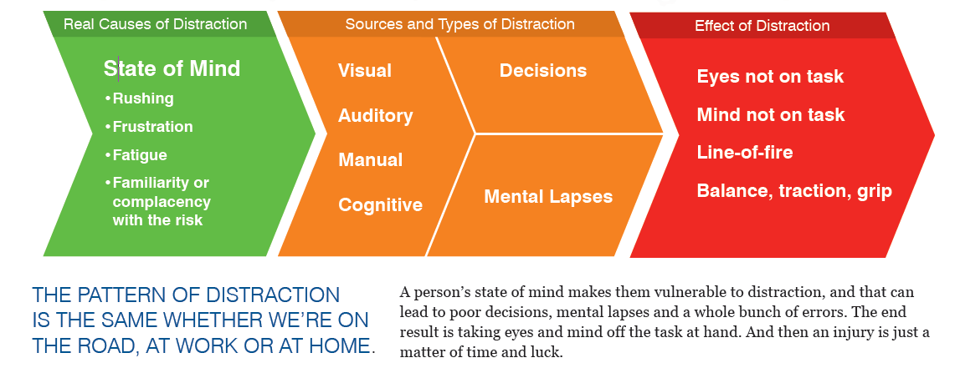
Complete Picture of Distraction
Arkansas Department of Transportation
Notes:
Highway Hypnosis(Mental Lapses)

Slide 17
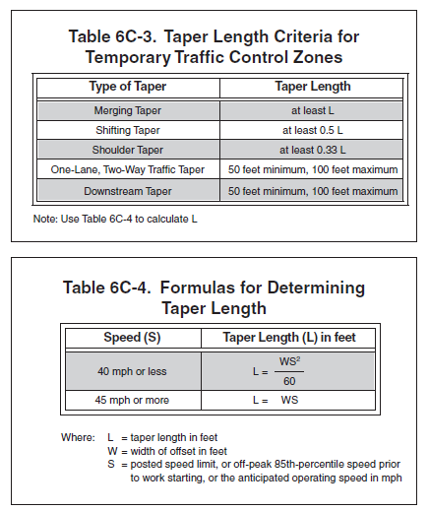
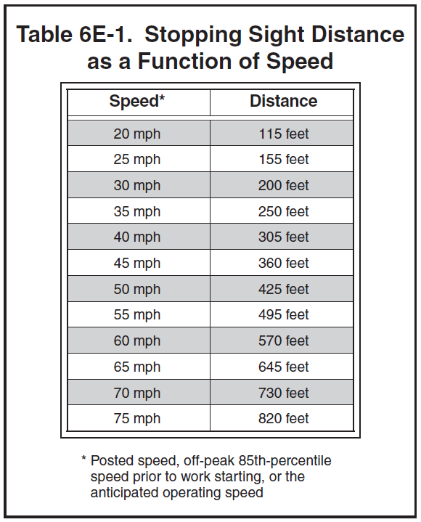
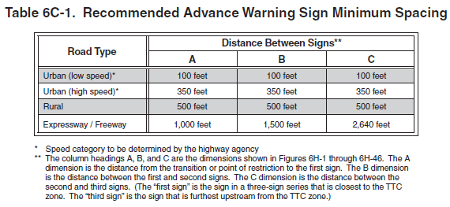
MUTCD
Arkansas Department of Transportation
Notes:
Why is buffer space important? These things help protect us when distracted drivers enter our work zones

Slide 18
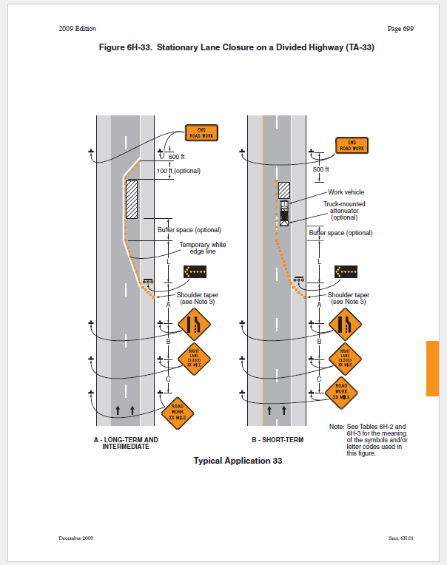
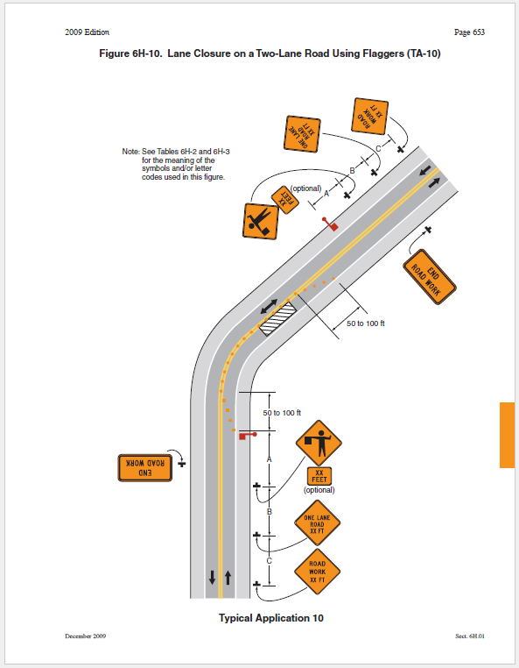
Typical Applications
Arkansas Department of Transportation
Notes:
Can anyone tell me the distance between signs and the length of the taper on a divided highway, 12 foot lanes & 70mph speed limit

Slide 19
Arkansas Department of Transportation
Performing Duties Properly
Proper Positioning
Be clearly visible
Never stand in lane used by moving traffic
Never stand among workers and equipment
Stand sufficiently in advance of the work zone
NO cell phones
Stay Alert at all times
Standing on shoulder
May move near centerline once traffic is stopped
Don’t stand near workers or equipment
Don’t stand in shade, over the crest of a hill or around a sharp curve
Be visible
ESCAPE ROUTE

Slide 20
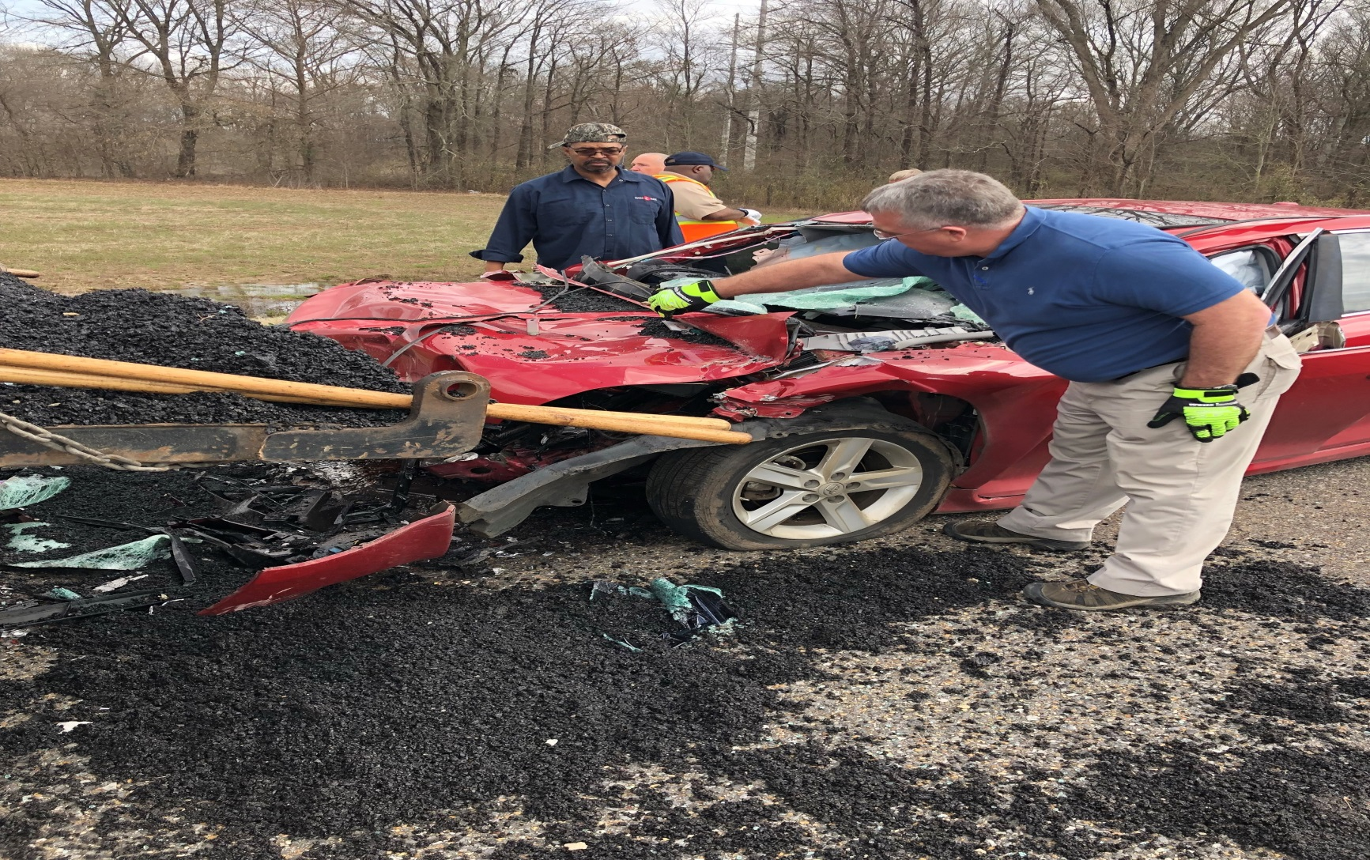
Highway 65
Arkansas Department of Transportation

Slide 21
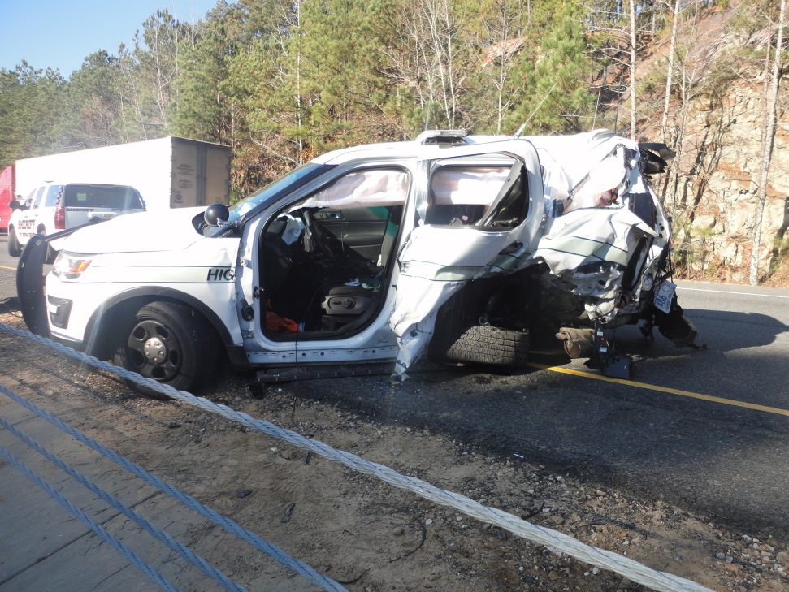
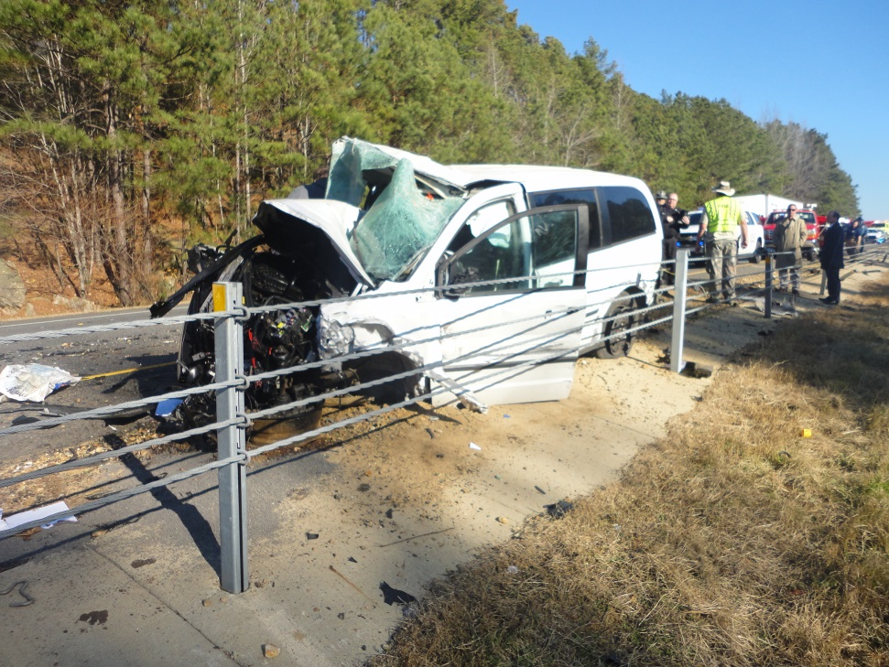
Interstate 30
Arkansas Department of Transportation

Slide 22
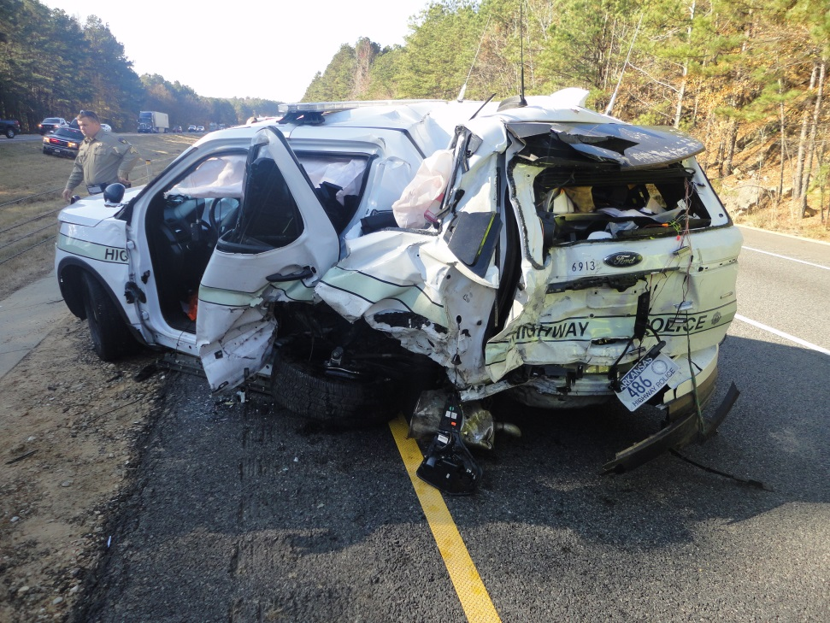
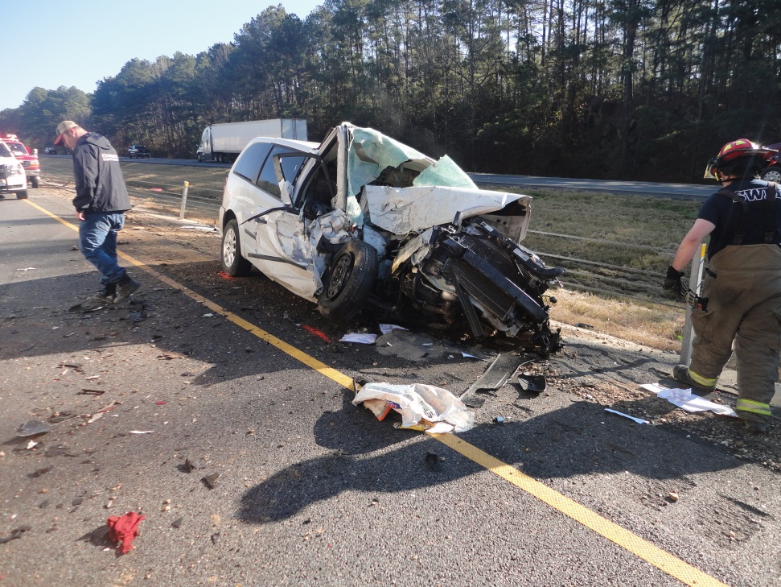
Interstate 30
Arkansas Department of Transportation

Slide 23
Tips for Driving Safely in Work Zones
Arkansas Department of Transportation
Know Before You Go
Wear Your Seatbelt
Expect the Unexpected
Avoid Distractions
Pay Attention to Other Drivers
Don’t Speed or Tailgate
Obey Road Crews and Signs
Be Patient and Stay Calm

Slide 24
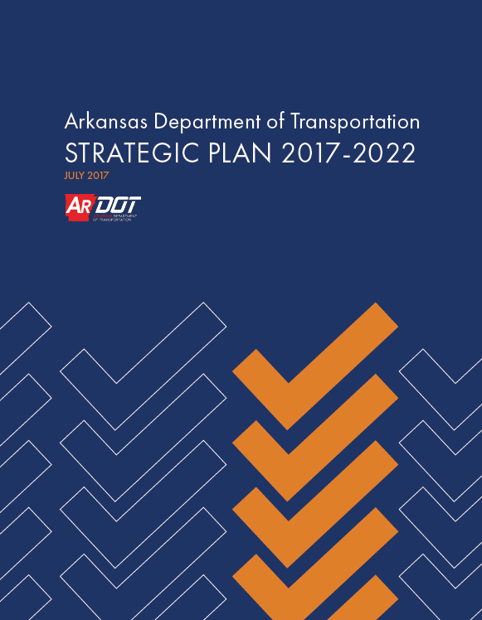
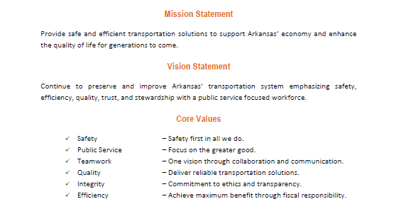
Strategic Plan
Arkansas Department of Transportation

Slide 25
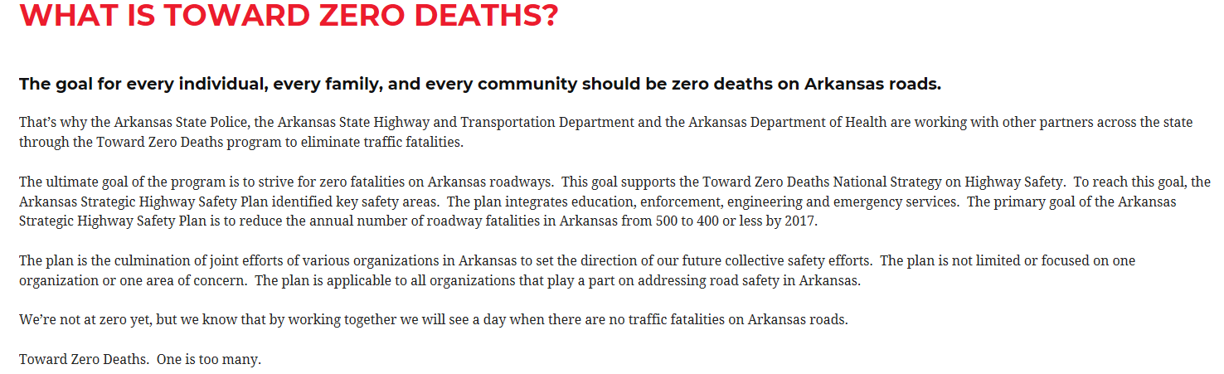
Strategic Highway Safety Plan
Arkansas Department of Transportation
Notes:
If you feel different, you drive different

Slide 26

Multi-Agency Program
Arkansas Department of Transportation
Education
Enforcement
Engineering
Emergency Services
Notes:
Engineering
• Continue to implement the Arkansas Work Zone Safety and Mobility Policy.
• Apply work zone countermeasures to reduce end of queue crashes.
• Improve work zone management.
Education
• Educate the public regarding work zone safety and penalties for violations in work zones.
Enforcement
• Involve law enforcement in work zones to reduce the risk of crashes.
Emergency Services
• Address incident response in work zones, particularly for high exposure projects.

Slide 27
References
Arkansas Department of Transportation
www.nhtsa.gov/risky-driving
2017 Arkansas Strategic Highway Safety Plan. www.ardot.gov
National Work Zone Awareness Week. www.ops.fhwa.dot.gov
Driving Away Distraction. www.safestart.com
Manual On Uniform Traffic Control Devices. https://mutcd.fhwa.dot.gov/
Notes:
If you feel different, you drive different

